Slide 1

Apache Log4j 2
Dima Ionut Daniel

Slide 2
Contents
What is Log4j 2?
Log4j 2 Features
Architecture
Log4j 2 Jars
Logger Levels
Log4j 2 API
Configuration
Appender
Layout
Filters
Async Loggers
JMX
Conclussion
Bibliography

Slide 3

What is Log4j 2?
Log4j2 is an upgrade to Log4j that provides significant improvements over Log4j.
Log4j2 is designed to be usable as an audit logging framework.
Log4j2 contains next-generation lock-free Asynchronous Loggers based on the LMAX Disruptor library.

Slide 4
Log4j 2 Features
Log4j 2 features:
faster than Log4j.
extensibility for components like: Appenders, filters, layouts, lookups, pattern converters.
Support for Message object.
Support for Filters to process events before they are handled by a Logger
Supports TCP/UDP appenders.
Uses Java 5 concurrency support and performs locking at the lowest level possible

Slide 5
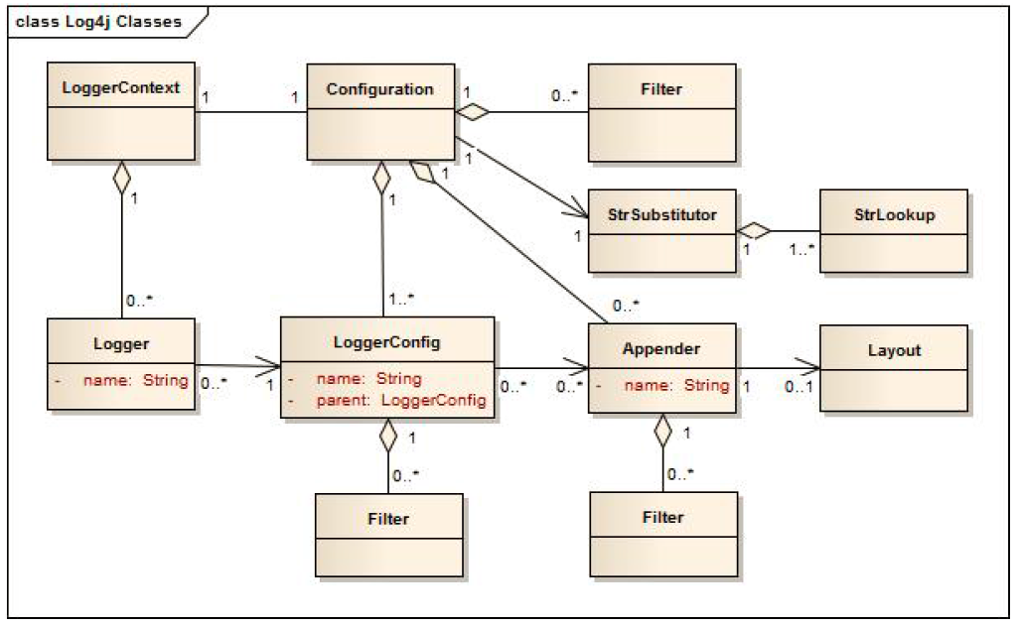
Architecture
Log4j 2 uses the classes in the bellow diagram.

Slide 6
Architecture
Applications request Logger objects from the LogManager.
The LogManager will locate the appropiate LoggerContext and then obtain the Logger from it.
Calling the LogManager.getLogger with the sane name it will always return a reference to the exact same Logger object.
The LoggerContext acts as the same anchor point for the Logging system.
Every LoggerContext has an active Configuration that contains appenders, filters, loggerConfigs,etc.
LoggerConfig objects are created when Loggers are declared in the logging configuration.

Slide 7
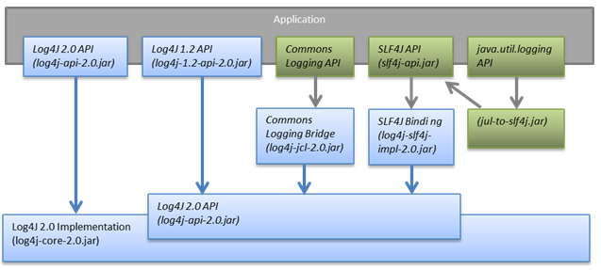
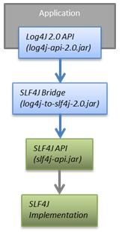
Log4j 2 jars
We need at least the log4j-api-2.0 and log4j-core-2.0 jar files.
We can use the log4j-to-slf4j adapter jar wjen the application calls the Log4j 2 but we want to route to SLF4J implementation.
By default the Log4j 2 is looking for log4j2.xml file in the classpath or it can be specified using the java env property Dlog4j.configurationFile=path_to_log4j2.xml file

Slide 8
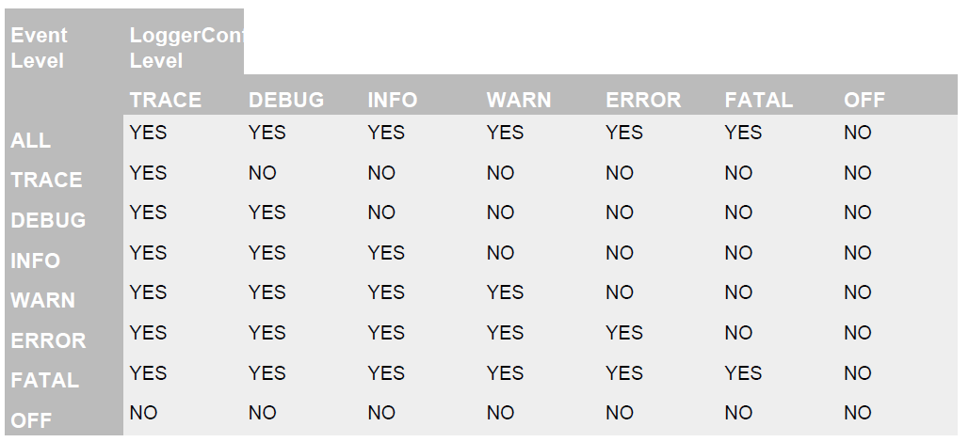
Logger Levels
Logger levels

Slide 9
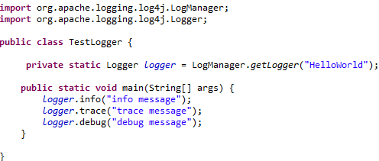
Log4j 2 APi
Log4j2 API provides the interface that applications should code.
It provides the adapter components required for implementers to create logging implementation.
Log4j 2 is split between an API and an implementation.
It supports subsituting parameters.

Slide 10
Configuration
Configuration can be done 4 ways:
Configuration file written in XML, JSON, YAML
Programmatically by using ConfigurationFactory, Configuration implementation
Programmatically by using Configuration interface and add components to the default configuration
Programmatically by using internal Logger methods.
Unlike Log4j 1.x the Log4j 2.x API doesn’t expose the add, modify, remove methods for appenders and filters.

Slide 11
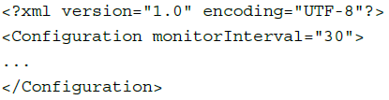
Configuration (cont.)
Log4j has the ability to automatically configure itself during initialization.
When Log4j 2 starts it will search the ConfigurationFactory plugins and arrange them based on priority.
By default Log4j 2 contains ConfigurationFactory implementations for JSON ,XML and YAML.
When configured from a File, Log4j has the ability to automatically detect changes of the configuration file and reconfigure itself.
The minimum monitorInterval value is 5 seconds and can be configured in the Configuration element.

Slide 12
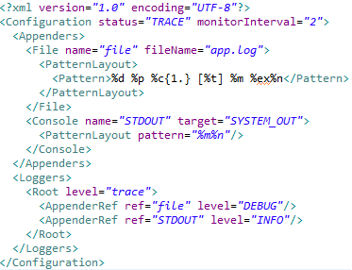
Configuration (cont.)
Log4j will provide a default configuration if it cannot locate a configuration file.
The default configuration will set up:
A ConsoleAppender attached to the root logger
A PatternLayout set to the pattern “%d{HH:mm:ss.SSS} [%t] %-5level %logger{36} - %msg%n” attached to the ConsoleAppender.
By default Log4j assigns the root logger to Level.ERROR.

Slide 13
Appender
Appenders are responsible for sending LogEvents to their destination.
Appender classes must implement the Appender interface or the AbstractAppender class.
AbstractAppender adds Lifecycle and Filterable support.
Lifecycle allows components to finish initialization after configuration has completed and to perform cleanup during shutdown.
Filterable allows the component to have Filters attached to it which are evaluated during event processing.

Slide 14
Appender (cont.)
Bundle appenders:
AsyncAppender - uses other Appender implementation and causes LogEvents to be written on a separate Thread.
ConsoleAppender - writes its output to either System.err or System.out.
FailoverAppender - wraps a set of appenders; if the primary Appender fails the seccondary appenders will be tried in order.
FileAppender - writes ot a file.
FlumeAppender - sends LogEvents to a Flume agent as Avro events for consumption.
JDBCAppender - writes log events to a relational DB using JDBC.
JMSQueueAppender - sends formatted log event to a JMS Queue.
JMSTopicAppender - sends the formatted log event to a JMS topic.
JPAAppender - writes log events to a relation db table using JPA 2.1.
NoSQLAppender - writes log events to a NoSQL databases using an internal lightweight provider interface.
RewriteAppender - allows LogEvent to be manipulated before it's processed by other Appender.
RollingFileAppender - writes to a file and rolls the file according to the TriggeringPolicy and the RolloverPolicy.
RoutingAppender - evaluates LogEvents and then routes them to a subordinate Appender.
SMTPAppender - sends e-amil when a specific logger event occurs, on error or fatal errors.
SocketAppender - writes to a socket based on host and port destination.

Slide 15
Layout
An Appender uses a Layout to format a LogEvent into a custom form.
In Log4j2 the layout object will return a byte array.
Built-in templates:
HTMLLayout will generate a HTML page and adds each LogEvent to a row into a table.
PatternLayout is a flexible layout configurable with pattern string.
RFC5424Layout formats LogEvent in accordance with RFC 5424.
SerialisedLayout serializezs the LogEvent into a byte array.
SyslogLayout formats the LogEvent as BSD Syslog records.
XMLLayout appends a series of Event to a file, using certain xml tags.

Slide 16
Filters
Filters allow Log Events to be filtered by certain rules.
A filter will be called if a Result object is returned with the following values: ACCEPT, DENY, NEUTRAL.
Bult-in filters:
BurstFilter provides a mechanism to control the rate at which LogEvents are processed.
CompositeFilter provides a way to specify more than one filter.
DynamicThresholdFilter allows filtering by log level based on specific attributes.
MapFilter allows filtering agains data elements that are in a MapMessage.
MarkerFilter compares the configured Marker value against the Marker that is included in the LogEvent.
RegexFilter allows the formatted or unformatted message to be compared against a regular expression.
TimeFilter can be used to restrict LogEvents on certain portion of the day.

Slide 17
Async Loggers
The async logging can improve the application performance by executing the I/O operations in a separate thread.
Log4j2 improvements:
Asynchronous logger: added in Log4j2.
LMAX Disruptor: it uses Disruptor library, a lock-free inter-thread communication library.
Asynchronous appenders: has been enhanced.
PROS:
Higher throughput
Lower logging latency
CONS:
Error handling

Slide 18
JMX
Log4j2 has built-in support for JMX.
JMX support is enabled by default.
When Log4j initializes, the StatusLogger, ContextSelector, LoggerContexts, LoggerConfig are instrumented with MBeans.
To disable JMX support the system property “log4j2.disable.jmx=true “ can be configured.

Slide 19
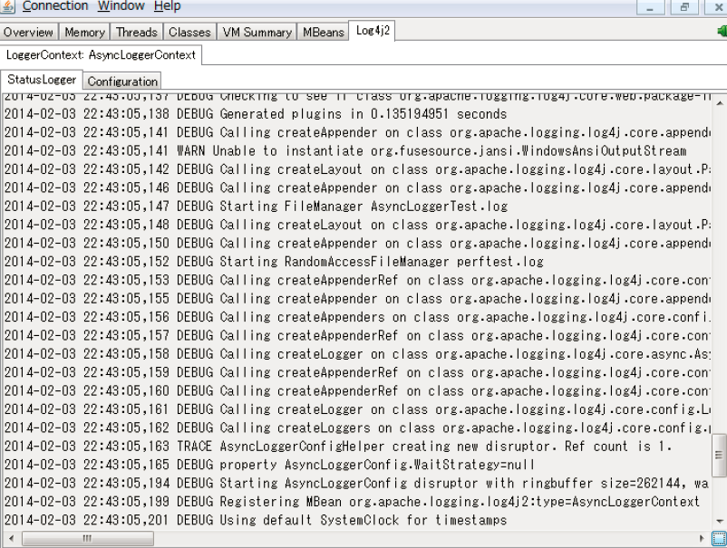
JMX (cont.)
Log4j2 includes a basic client GUI that can be run as standalone application or as JConsole plug-in.
%JAVA_HOME%\bin\jconsole -pluginpath \path\to\log4j-api-2.0.jar;\path\to\log4j-core-2.0.jar;\path\to\log4j-jmx-gui-2.0.

Slide 20
Conclussion
Log4j2 is easy to use.
Log4j2 is documented.
Log4j2 is configurable via external file or programatically.

Slide 21

Bibliography
http://wiki.apache.org/logging/log4j2
Log4j 2 User Guide.pdf
http://logging.apache.org/log4j/2.x/

Slide 22
Questions ?

